Slide 1
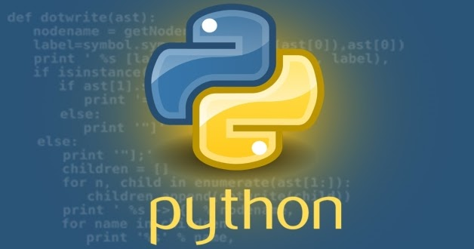
תכנות מונחה עצמים Python
תמונה זו מאת מחבר לא ידוע ניתן ברשיון במסגרת CC BY-SA-NC

Slide 2
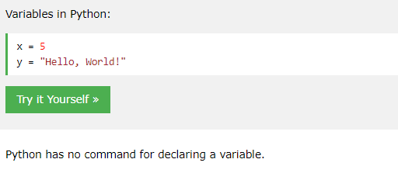
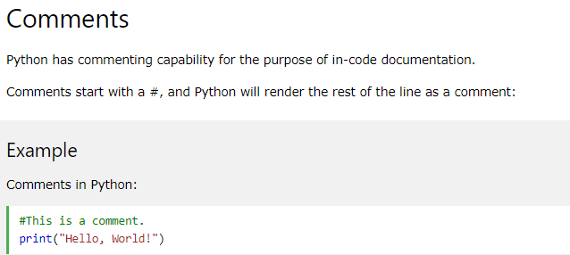
Python syntax basics
In Python, variables are created when you assign a value to it

Slide 3
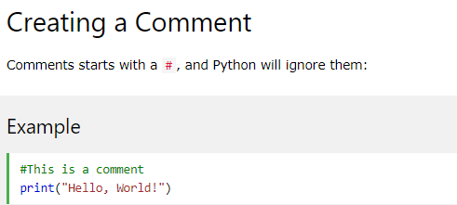
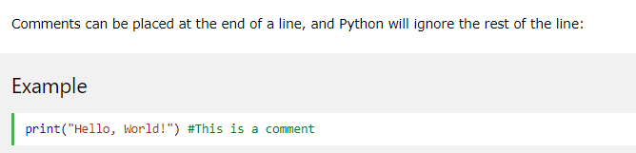
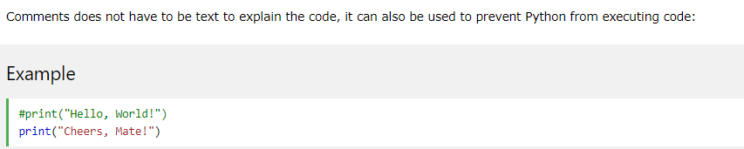
Python Comments
Comments can be used to explain Python code.
Comments can be used to make the code more readable.
Comments can be used to prevent execution when testing code.

Slide 4
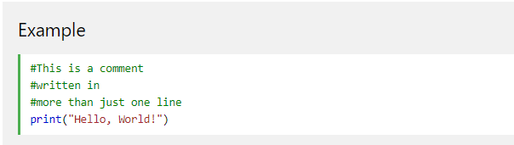
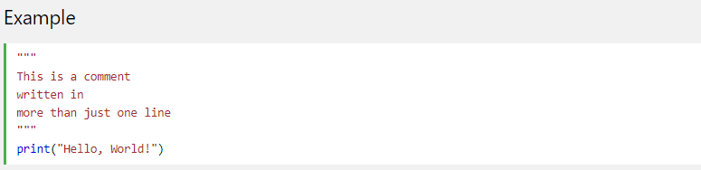
Multi Line Comments
First way for a Multi Line Comments
Second way for a Multi Line Comments

Slide 5
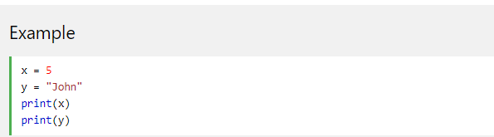

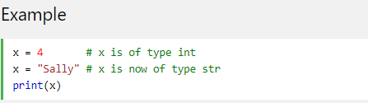
Python Variables
Creating Variables
Python has no command for declaring a variable.
A variable is created the moment you first assign a value to it.
Variables do not need to be declared with any particular type, and can even change type after they have been set.

Slide 6
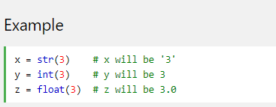
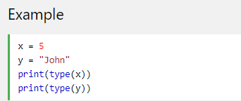
Python Variables
If you want to specify the data type of a variable, this can be done with casting.
Get the Type
You can get the data type of a variable with the type() function.

Slide 7
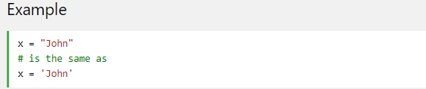
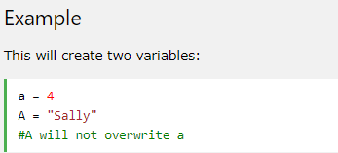
Python Variables
Single or Double Quotes? (Same as java)
String variables can be declared either by using single or double quotes:
Case-Sensitive (Same as java)
Variable names are case-sensitive.

Slide 8
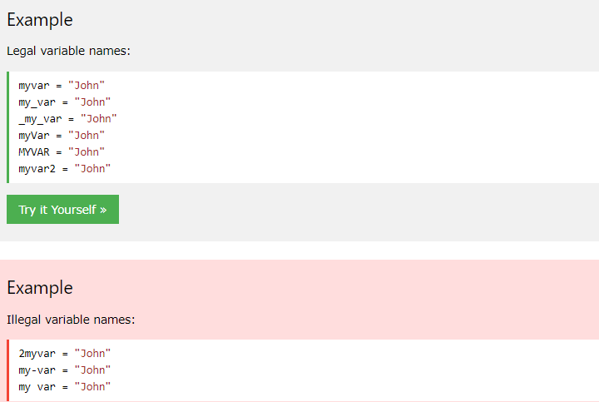
Python - Variable Names
A variable can have a short name (like x and y) or a more descriptive name (age, carname, total_volume).
Rules for Python variables:
A variable name must start with a letter or the underscore character
A variable name cannot start with a number
A variable name can only contain alpha-numeric characters and underscores (A-z, 0-9, and _ )
Variable names are case-sensitive (age, Age and AGE are three different variables)

Slide 9
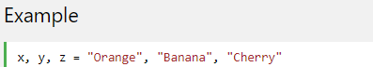
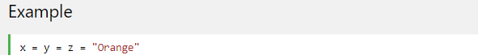
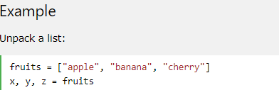
Python Variables - Assign Multiple Values
Many Values to Multiple Variables
Python allows you to assign values to multiple variables in one line:
One Value to Multiple Variables
And you can assign the same value to multiple variables in one line:
Unpack a Collection
If you have a collection of values in a list, tuple etc. Python allows you extract the values into variables. This is called unpacking.

Slide 10
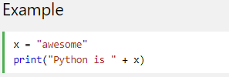

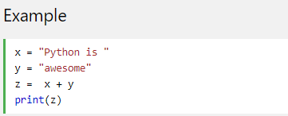

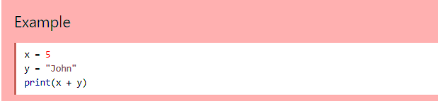
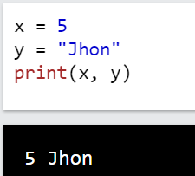
Output Variables
The Python print statement is often used to output variables.
To combine both text and a variable, Python uses the + character:
You can also use the + character to add a variable to another variable:
In order to print different types you can print with "," instead of "+"
If you try to combine a string and a number, Python will give you an error:

Slide 11
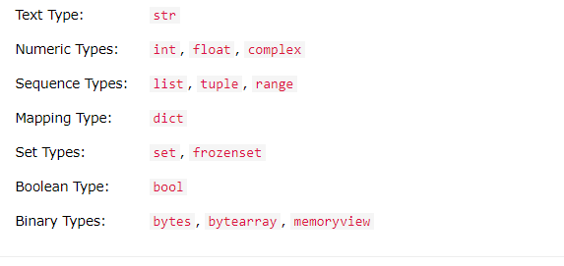
Python Data Types
Built-in Data Types
In programming, data type is an important concept.
Variables can store data of different types, and different types can do different things.
Python has the following data types built-in by default, in these categories:

Slide 12
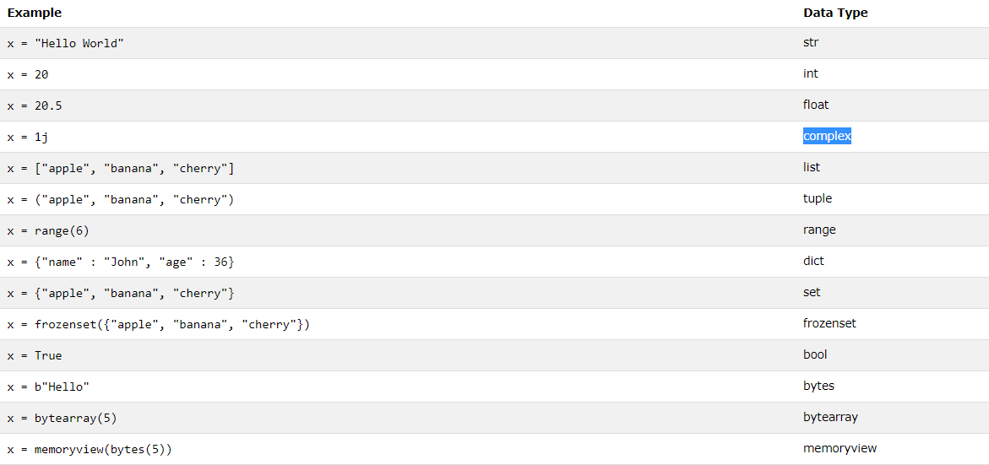
Python Data Types Cont.
In Python, the data type is set when you assign a value to a variable:

Slide 13

Random Number
Random Number
Python does not have a random() function to make a random number, but Python has a built-in module called random that can be used to make random numbers:
Example
Import the random module, and display a random number between 1 and 9:

Slide 14
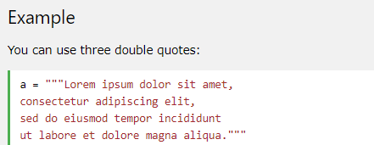
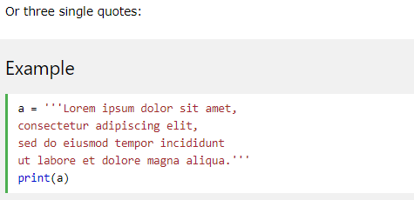
Multiline Strings
You can assign a multiline string to a variable by using three quotes:

Slide 15
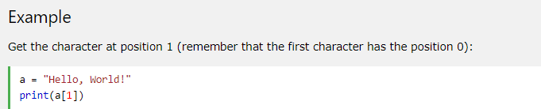

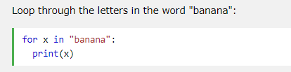
Strings are Arrays
Like many other popular programming languages, strings in Python are arrays of bytes representing unicode characters.
However, Python does not have a character data type, a single character is simply a string with a length of 1.
Square brackets can be used to access elements of the string.
Looping Through a String
Since strings are arrays, we can loop through the characters in a string, with a for loop.

Slide 16
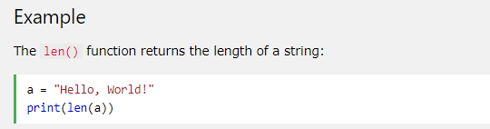
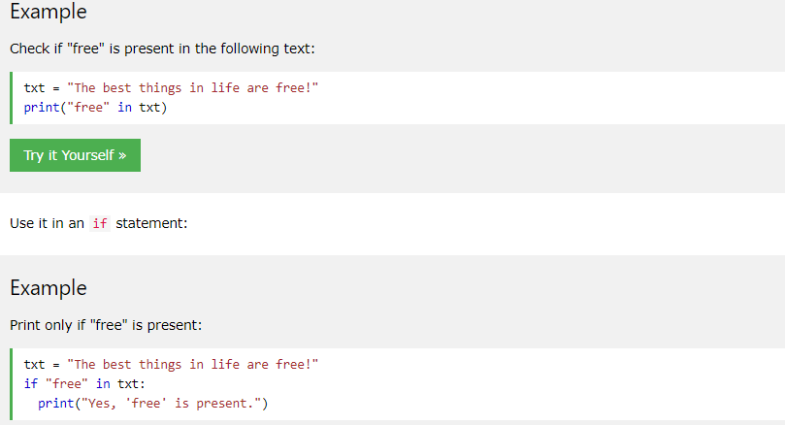


Strings are Arrays
String Length
To get the length of a string, use the len() function.
Check String
To check if a certain phrase or character is present in a string, we can use the keyword in.

Slide 17
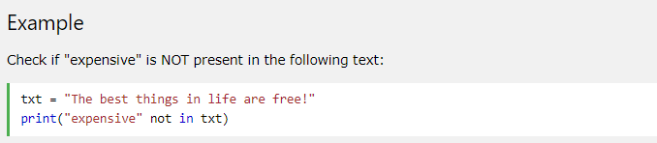
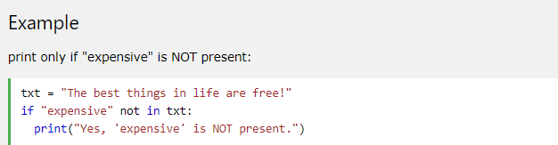

Strings are Arrays
Check if NOT
To check if a certain phrase or character is NOT present in a string, we can use the keyword not in.

Slide 18
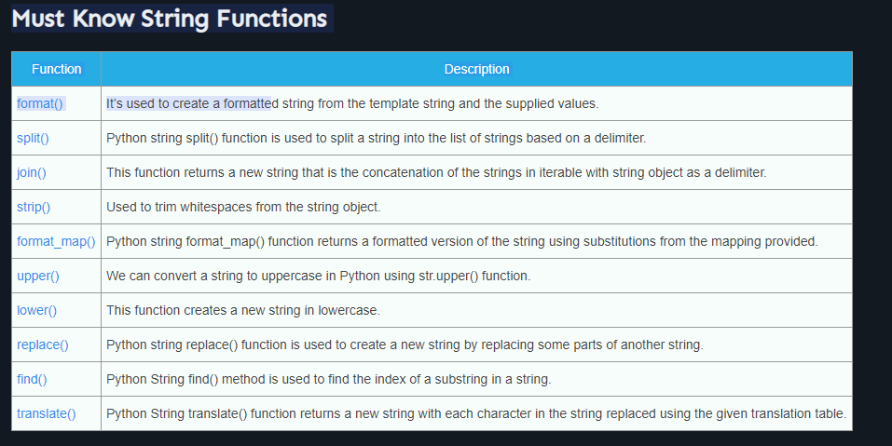
Strings

Slide 19
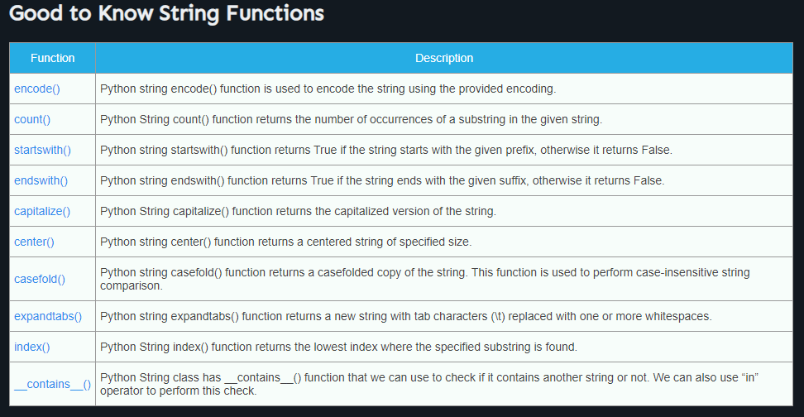
Strings

Slide 20
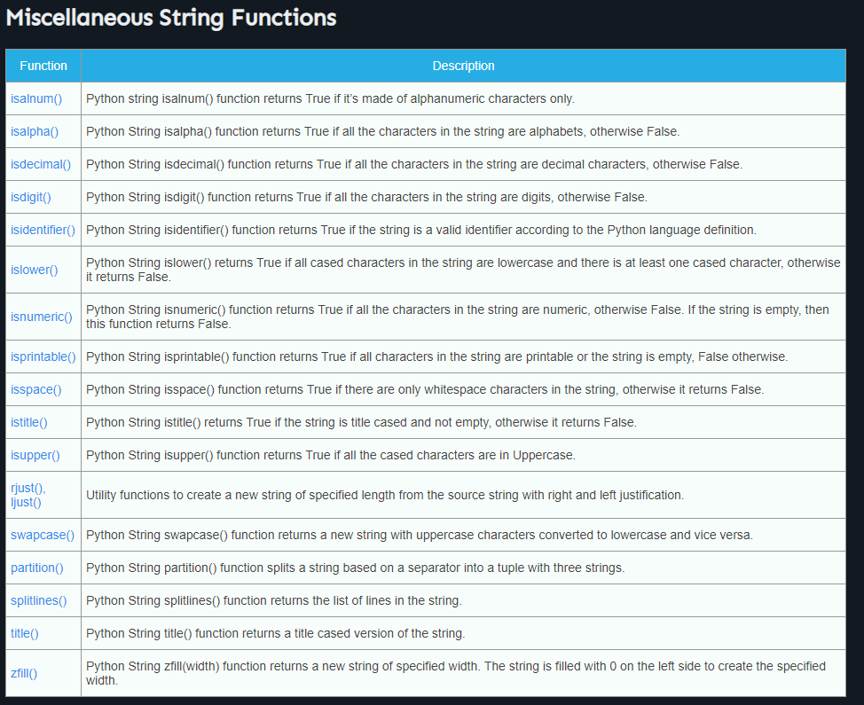
Strings

Slide 21
Strings

Slide 22
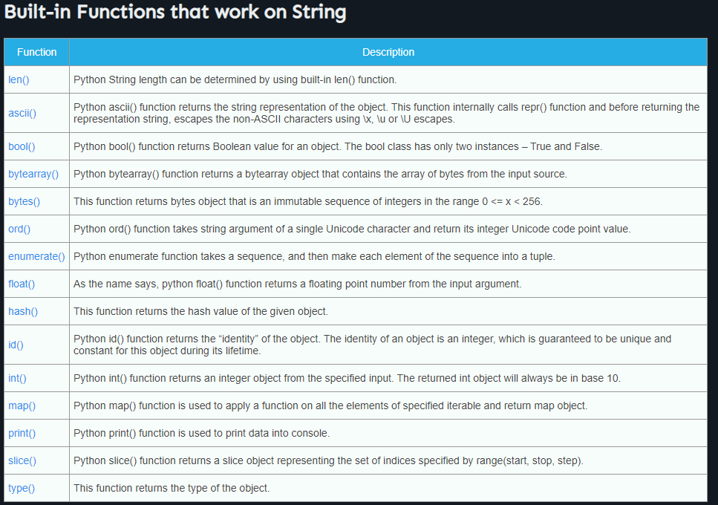
Strings

Slide 23
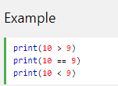

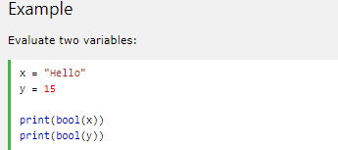

Python Booleans
Booleans represent one of two values: True or False.
Boolean Values
In programming you often need to know if an expression is True or False.
You can evaluate any expression in Python, and get one of two answers, True or False.
When you compare two values, the expression is evaluated and Python returns the Boolean answer:
Evaluate Values and Variables
The bool() function allows you to evaluate any value, and give you True or False in return,

Slide 24
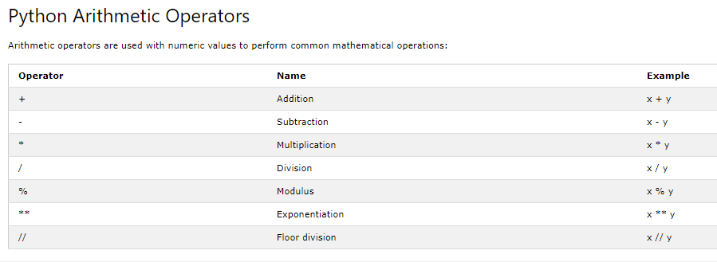
Python Operators
Python Operators
Operators are used to perform operations on variables and values.
In the example below, we use the + operator to add together two values:

Slide 25
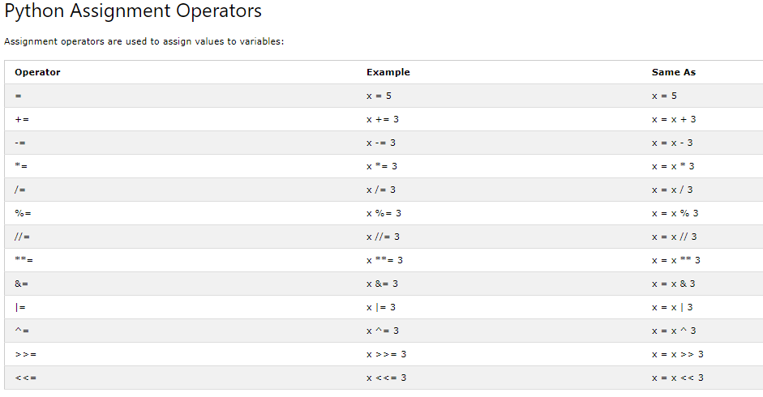
Python Operators

Slide 26
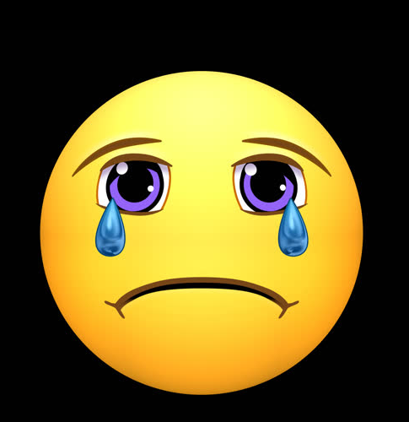
Python Operators
i++
i += 1

Slide 27
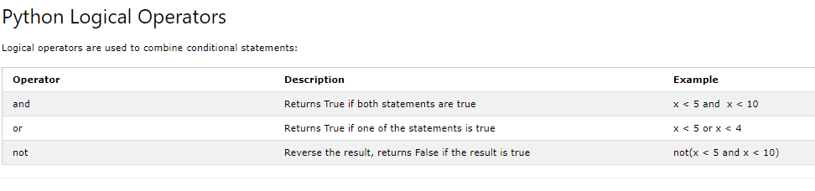
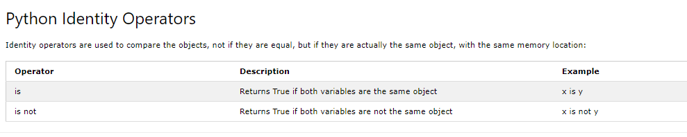
Python Operators

